Slide 1

Project Name:
Different Sorting Visualization
By
Student Name : Kunal Saha
(B.Tech 3rd Year, Enrollment No.: 12019002001083)
Under the Supervision of
Guide Name : Dr. Prof. Mirnal Kanti Sarkar
Dept. of Computer Science & Engineering
University of Engineering & Management, Jaipur

Slide 2
Introduction
* This project is basically a Graphical Visualization of different types of Sorting Algorithms in Computer Programming.
* This is a done by Python 3 Programming language.
* This will help to understand the inside working of each sorting algorithms more prominently.

Slide 3
Literature Review
Used Visual Code as idle
Python 3 libraries used are:
Tkinter library :- for the GUI part
ttk function from Tkinter library :- for the drop down box in the frame.
Random :- to the array for sorting
Time :- whenever a swap happens this is a time gap to understand the visualization

Slide 4
It will help students to understand the inside working of each algorithms more appropriately and to clarify the swaps between each numbers in any sorting algorithm more clearly. More over it helps me to use data structure and algorithms in real life projects.
Objectives

Slide 5
Proposed Model
After running the .py file it will open the GUI where there are different buttons , drop down box and options to perform the sorting.
Once you will select the desire sorting method from the drop down you have to select the size of the array .
Then you have to adjust the speed of the sorting.
Then you have to set the upper limit and the lower limit of the array to be sorted.
Then click on the Current Array button, it will generate a random array of given size, lower and upper limit in the form of rectangular bars in unsorted order.
Then click on Start Sorting button to sort the array.

Slide 6
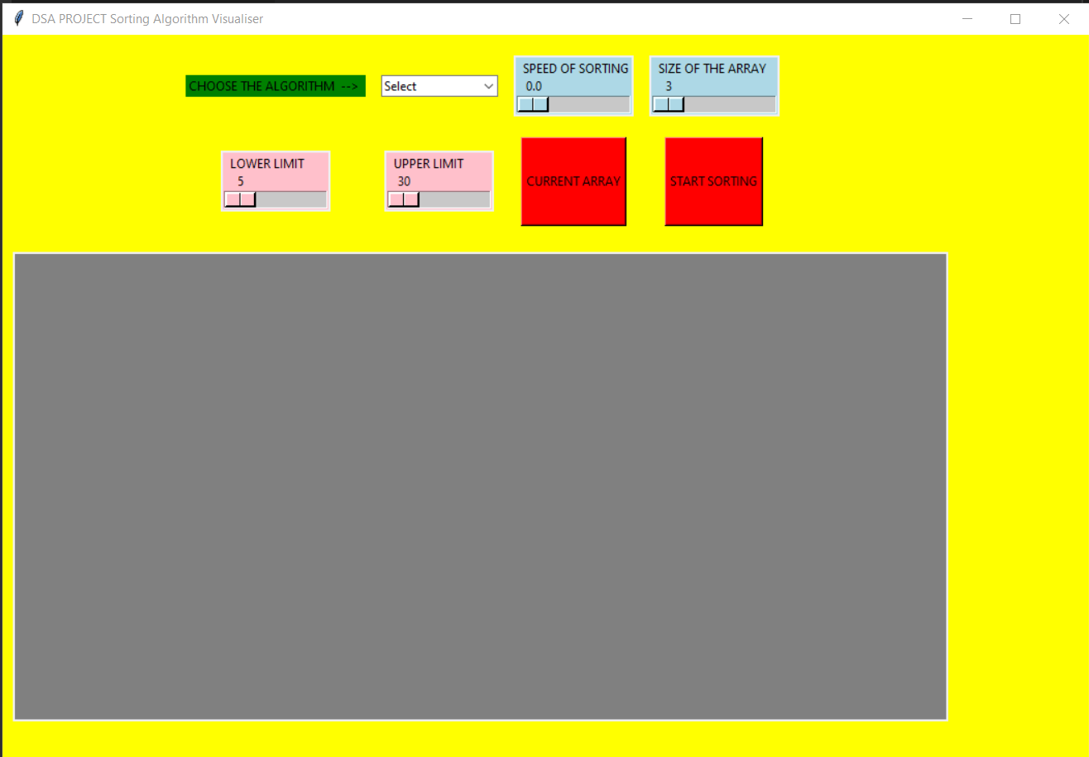
Experimental Set-up
Select an Sorting algorithm from this drop down
Adjust the speed of the Sorting
Adjust the Size of the Array
Set the Lower limit of the array
Set the Upper limit of the array

Slide 7
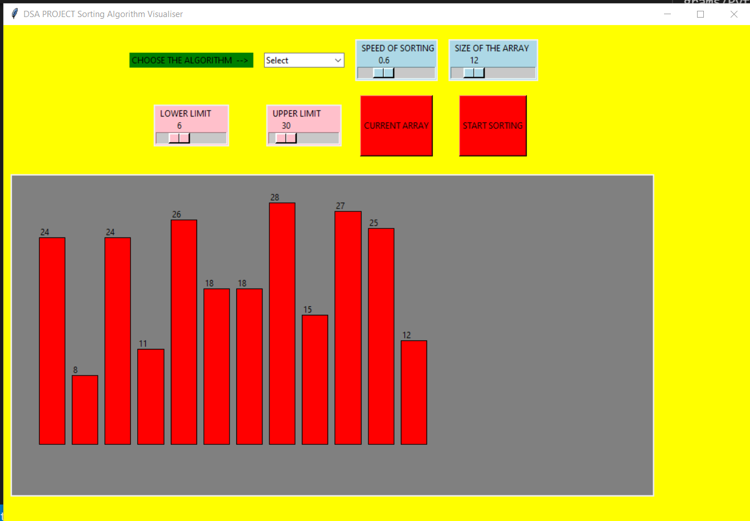
Result: Example
Then click on this to start the sorting
After setting all values we have to click on this button to generate the array in this bar graph representative way.

Slide 8
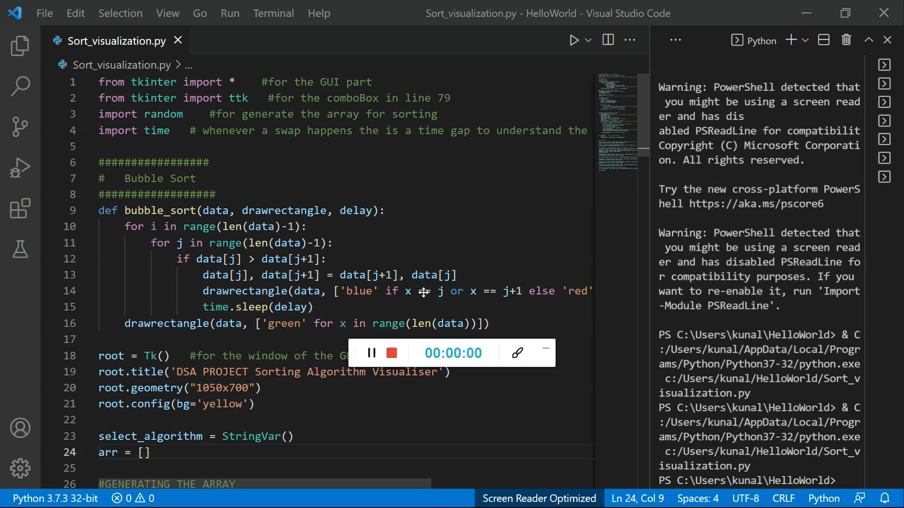
Result Analysis
Please play this below video to understand the inside working of the project more clearly.

Slide 9
Limitation
While running the sorting, the value of the contents cannot be changed
If the GUI will open for a long time or different changes would made on it in one single run then sometimes it might stop running(totally depends on the idle used).

Slide 10
Conclusions & Future Scope
This is a very basic level implementation of the sorting visualization .
Further this project can be modified by introducing different kind of sorting technique into it.
The GUI design can also be modified.

Slide 11
References
I would really like to thank Ankush Sir from Coding Ninjas to share such an unique project idea in the live session which has practical implementation of Data Structure and Algorithms.
This project will definitely help to understand the different sorting technique when implemented on large scale.

Slide 12
Acknowledgement
I think all of you liked my projects. I had only tried to come up with something innovative idea that can be implemented further on a large scale.
I have done this project under the supervision of
Dr. Prof. Mrinal Kanti Sarkar.
I am also trying to make a better version of it and thinking how I can able to minimize the flaws in this projects.
Please give your valuable feedback on this and if possible tell me how can I modify my project to make a better version of it.

Slide 13

Dept. of CSE, University of Engineering & Management Jaipur

